Slide 1

ABOUT THIS DECK
*Delete this slide before presenting. For team info purposes only.
This sponsorship deck is provided as a tool for South Boston Speedway teams.
How to use:
  The deck is provided generic. You are welcome to change out photos, logos, etc. throughout.
  The information at the beginning is all about South Boston Speedway and includes mostly analytical data. We ask that you please only use this for proposals and not share with the public as much of the data is for business purposes only and is not fan-facing information.
Questions or need help?
  Email chase@southbostonspeedway.com or carly@southbostonspeedway.com
  Or call (434) 572-4947

Slide 2
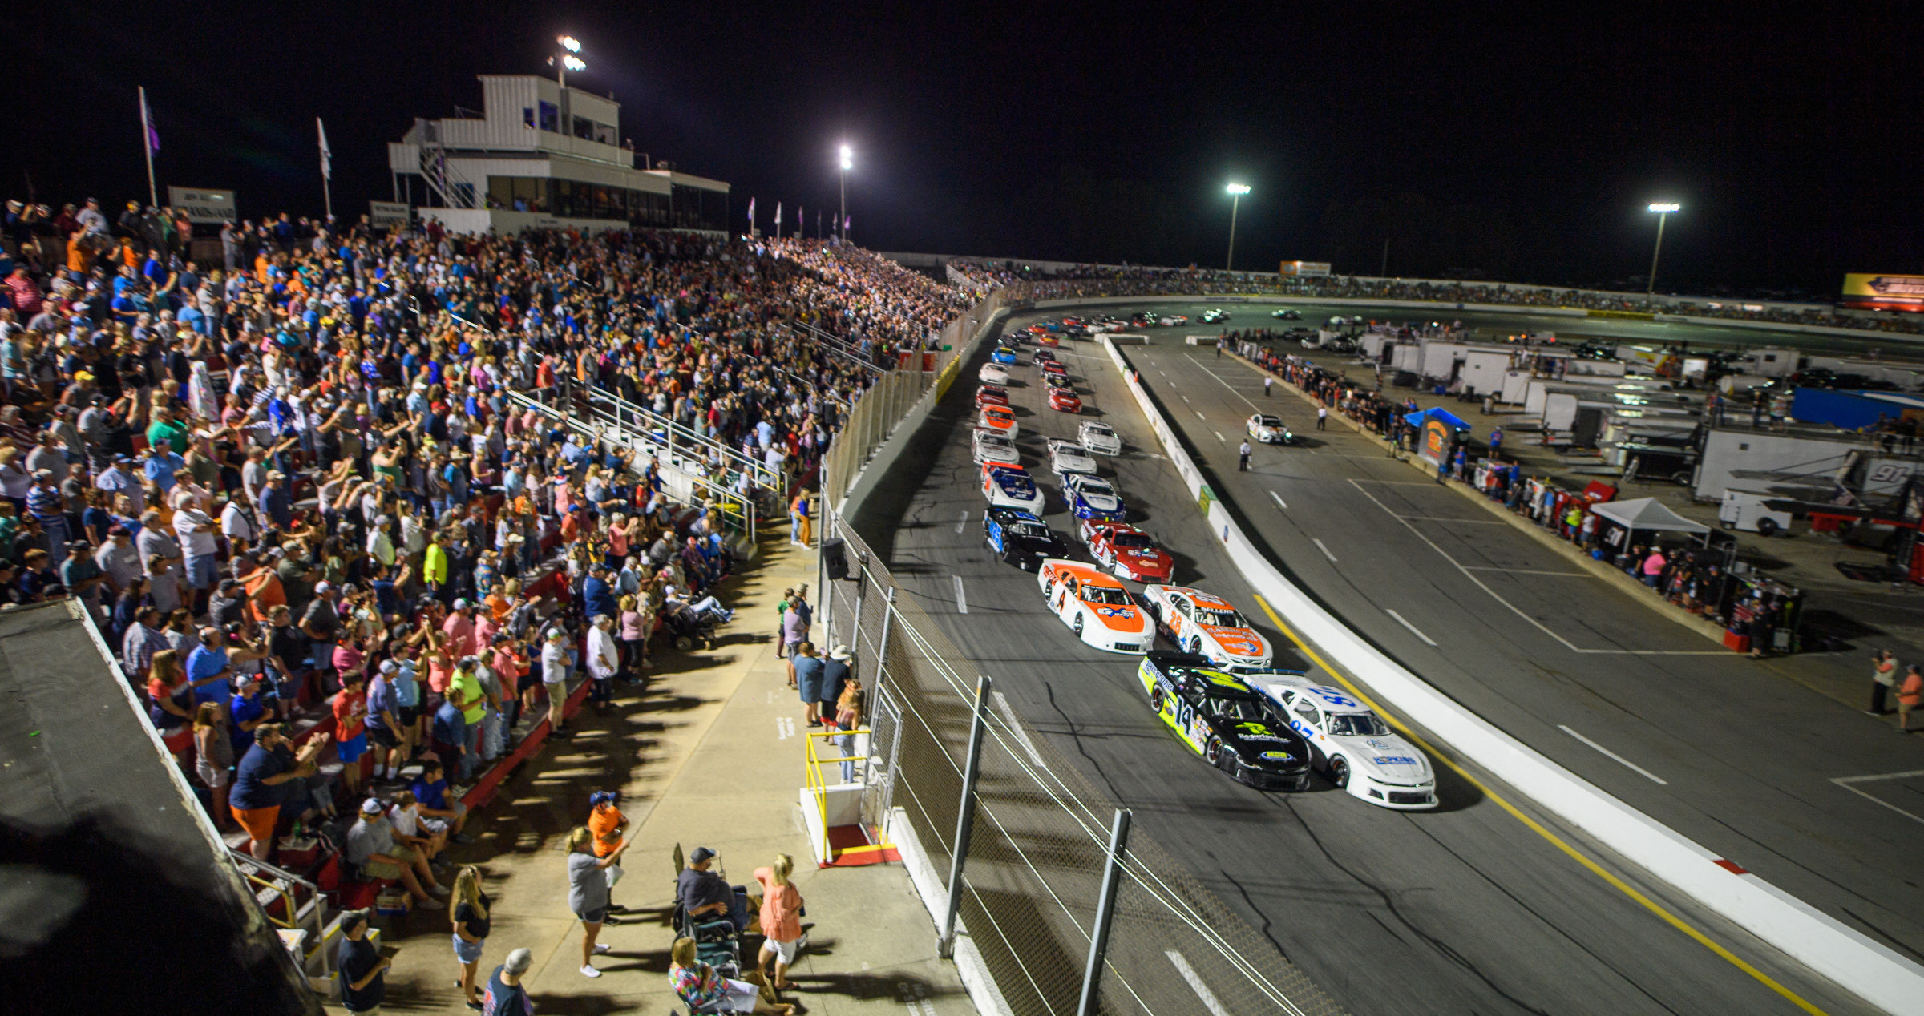



TEAM MARKETING OPPORTUNITIES
INSERT TEAM NAME HERE

Slide 3
HISTORY
Track Facts
Banking 12-degree turns / 10-degree straightaways
Racing Surface Width – 45 feet
Straightaway Length – 360 feet
Established in 1957
Part of the international NASCAR Advance Auto Parts Weekly Series / NASCAR Home Tracks program
Featured on iRacing
Sister track to Pocono Raceway
Home track to many NASCAR stars – including Jeff Burton, Ward Burton, Elliot Sadler and Hermie Sadler

Slide 4
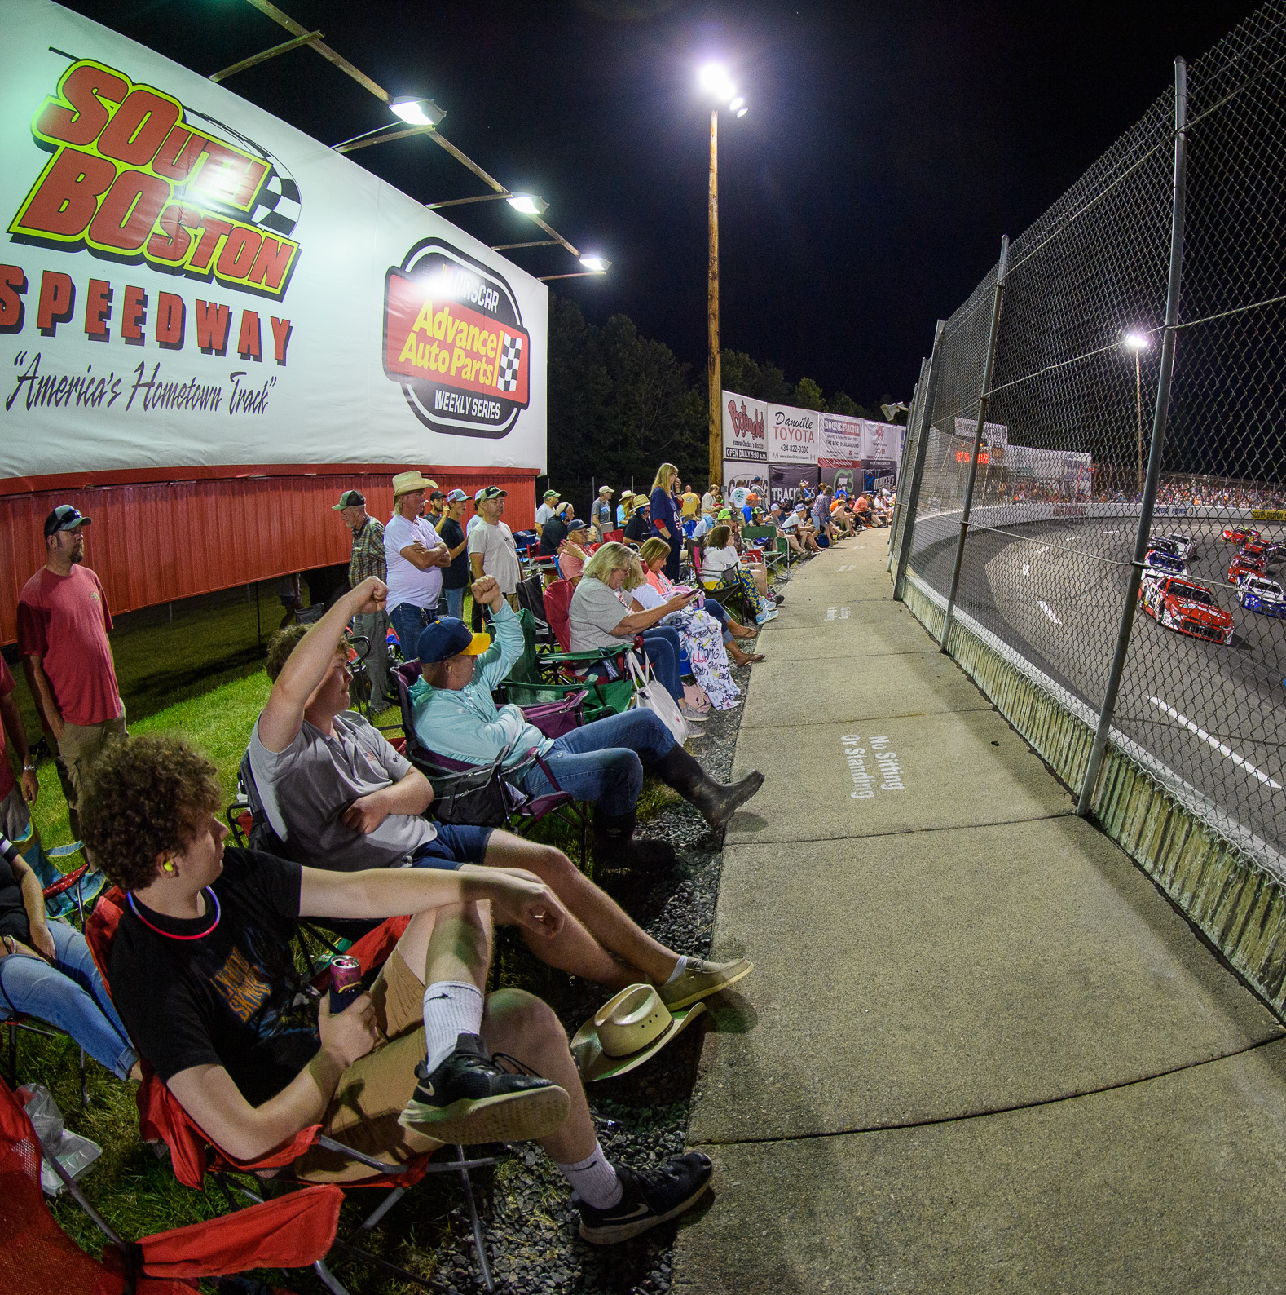
WHY SOBO?
A local, regional and nationally recognized brand
Loyal and dedicated fanbase
Direct-to-consumer approach
Tailored and budget-friendly partnership opportunities
In-person and social / digital media exposure for partners
Direct access to Speedway fans with activation opportunities
Family atmosphere
Thousands of loyal fans in attendance and thousands more impressions online
Event livestreaming pushing brands to people (literally) across the country
Community stewardship
  Partners enjoy engaging the community at large

Slide 5
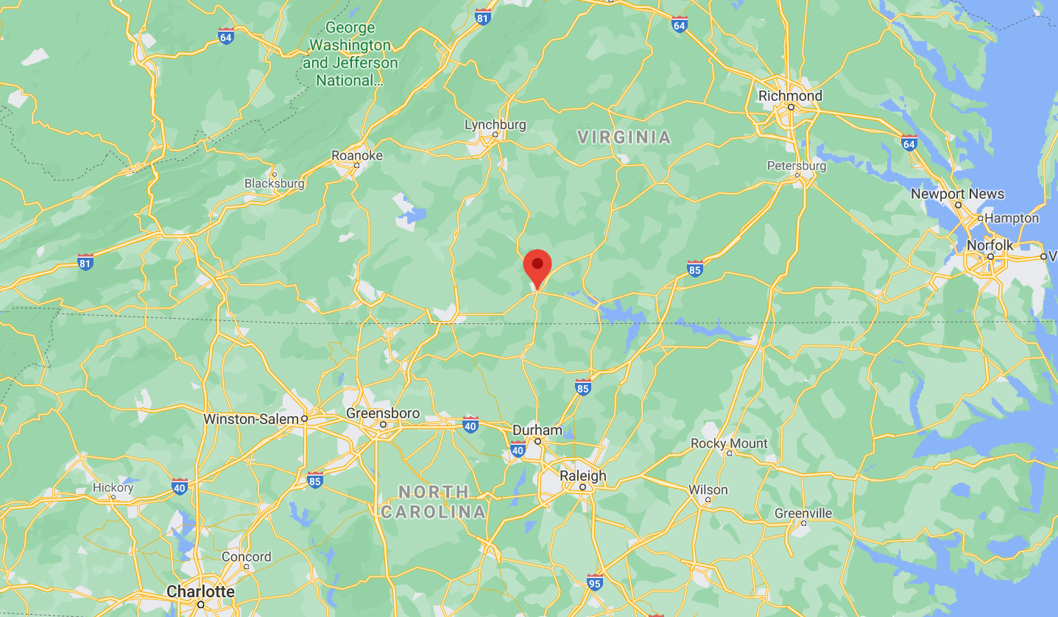
LOCAL. REGIONAL. NATIONAL.
South Boston Speedway is located within 3 hours of 7 million people
Danville, VA
Micro Area
Population: 65,000
Distance: 30 mins.
Durham, NC
Metro Area
Population: 644,000
Distance: 1 hour
Greensboro, NC
Metro Area
Population: 771,000
Distance: 1 hr. 30 mins.
Martinsville, VA
Micro Area
Population: 103,000
Distance: 1 hr. 30 min.
Raleigh, NC
Metro Area
Population: 1.3 million
Distance: 1 hr. 45 mins.
Winston-Salem, NC
Metro Area
Population: 666,000
Distance: 1 hr. 50 mins.
South Boston, VA
Richmond, VA
Metro Area
Population: 1.3 million
Distance: 2 hours
Roanoke, VA
Metro Area
Population: 318,000
Distance: 2 hours
Charlotte, NC
Metro Area
Population: 2.2 million
Distance: 3 hours

Slide 6
STRONG SUPPORT OF LOCAL RACING SPONSORS
NASCAR Regional / Local Series fans are very supportive of NASCAR sponsors. Compared to “Other NASCAR Fans,” NASCAR Regional / Local Series fans are approximately twice as likely to:
Talk positively about brands that are sponsors in NASCAR.
Feel loyal to NASCAR sponsors and purchase their products/services because of their involvement in the sport.
Continue to support NASCAR sponsors more than other brands during tough economic times, because of the commitment they show to the sport.
Support NASCAR sponsors more than sponsors of other sports.
Always buy products or services from companies that sponsor NASCAR.
Always participate in NASCAR sponsors’ promotions, such as sweepstakes, coupons, mail-to win, etc.
Data supplied by NASCAR | 2014

Slide 7
OUR FANS SUPPORT BUSINESSES THAT SUPPORT US
How likely are you to support businesses that support South Boston Speedway?
True / False: I am more loyal to companies that support South Boston Speedway versus those that do not.
Less likely
False
No difference
Somewhat or definitely more likely
True
Data supplied by South Boston Speedway | July 2021 Fan Survey

Slide 8


THE STRONGEST FAN SUPPORT IN SPORTS
Proportion of Each Sport’s Avid Fans who Are More Likely to
Support the Sport’s Official Sponsors in the Following Ways
Q: Are you more or less likely to [INSERT LOYALTY METRIC] a product / service if that product / service is an official sponsor of [INSERT SPORT]?
Source: Turnkey Sports & Entertainment, results published in SBJ, n=400 for each sport’s entire study
Note: Data reflects latest results for each sports property as of December 2017

Slide 9
THE NUMBERS
South Boston Speedway and nearby Virginia International Raceway bring over $50 million dollars into Halifax County, VA
(source: Halifax Co., VA Chamber of Commerce, 2019)
Email:
  The Speedway manages an active CRM/email system with thousands of accounts
In-Person:
  Average events attract 2,500-3,000 people. Larger events attract 7,000 or more people.
  Annually the track brings in over 45,000 guests.
Digital media
  Website - over 400,000 views per year
  Social media – FOUR MILLION annual social media reach/impressions

Slide 10
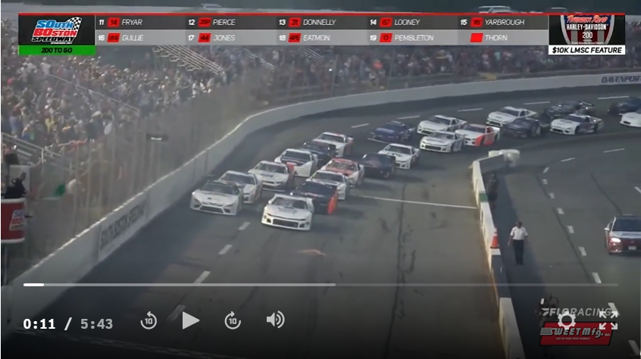


WORLDWIDE LIVESTREAMING
South Boston Speedway events are streamed worldwide by FloRacing (floracing.com)
FloRacing is a platform by FloSports which streams thousands of motorsports events a year and is partnered with hundreds of racetracks, series’, drivers (Tony Stewart, Kyle Larson, etc.)
FloSports streams tens of thousands of events a year from bowling, basketball, football, wrestling, motorsports and much more across the globe
Speedway controls the video/audio of the broadcast via a in-house production studio
Specific 2022 viewership data will be available Jan. 2023. Events generally are viewed by a few thousand and can be up to 10,000

Slide 11
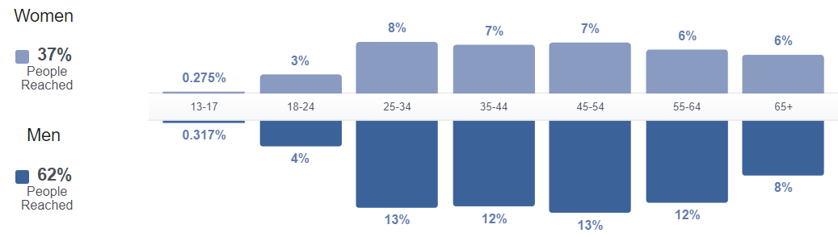
WHO ARE OUR FANS?
Top Markets:
  South Boston, VA / Halifax County, VA
  Danville, VA
  Roanoke, VA
  Lynchburg, VA
  Virginia Beach VA
  Charlottesville, VA
  Charlotte, NC
  Charlottesville, VA
  Raleigh, NC
Who’s at our events:
  Fans / Spectators
  Race teams – drivers, crew members, families
  Sponsors (B2B)
  Streaming – viewers across the country; live and DVR
* Our attendees travel! Roughly half of our attendees travel one-two hours to attend events.

Slide 12
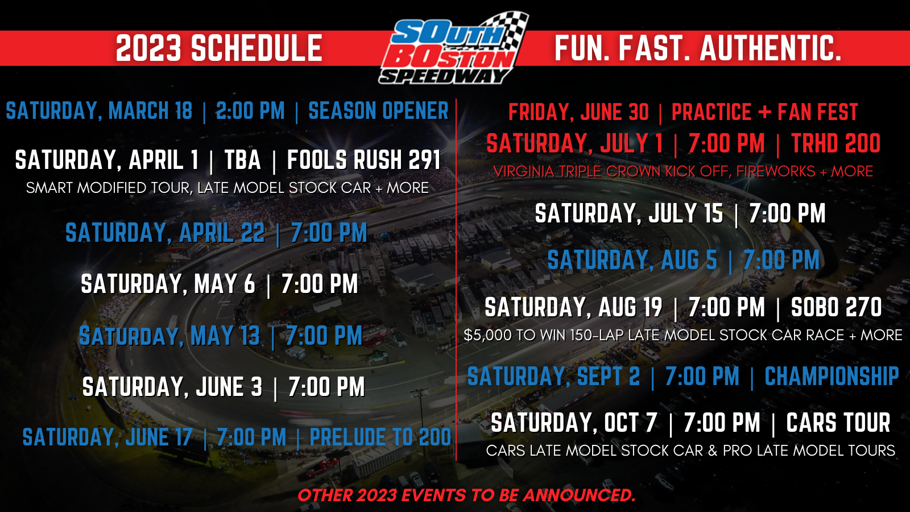
Others events TBA.
Above motorsports schedule does not include rental events or March 4 drifting event.

Slide 13
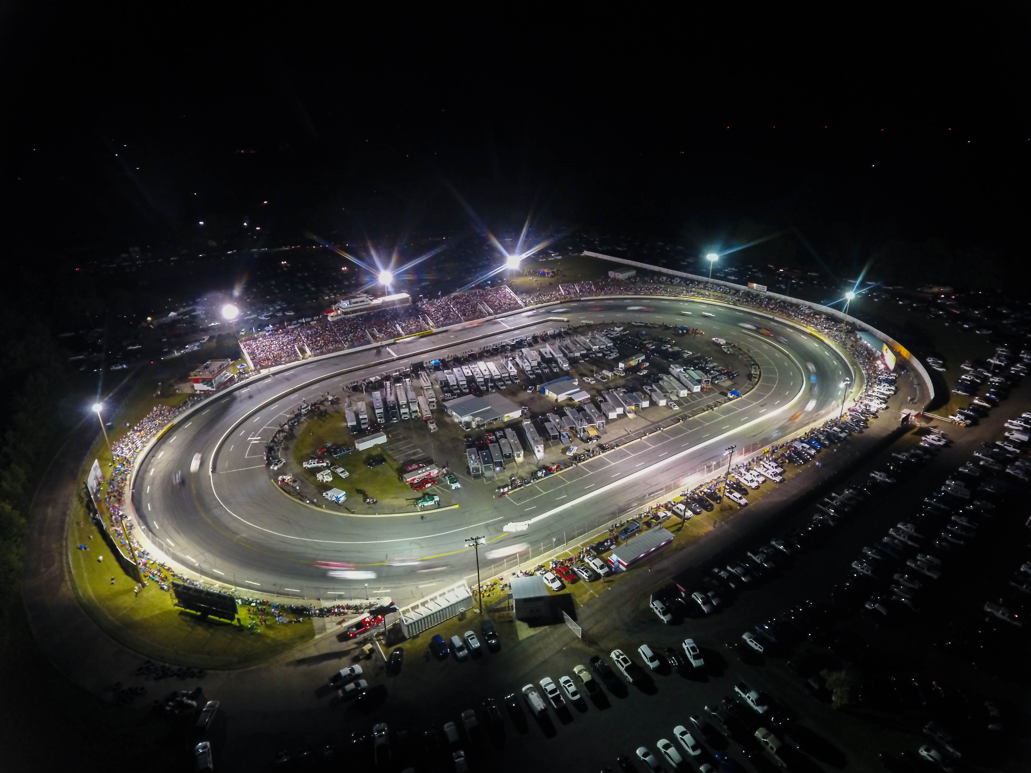
TEAM MARKETING OPPORTUNITIES
INSERT TEAM NAME HERE
Fun. Fast. Authentic.

Slide 14
USE THIS SLIDE & OTHERS TO DETAIL PARTNERSHIP
Use realistic data if you have it. Be specific.
Don’t have a lot of bullet points. Use visuals (photos, graphs, etc.) when possible.
To add more slides, click New Slide or right click and duplicate this slide.

Slide 15
CONTACT INFORMATION
NAME
Phone: 123-456-7890
email@email.com

Slide 16
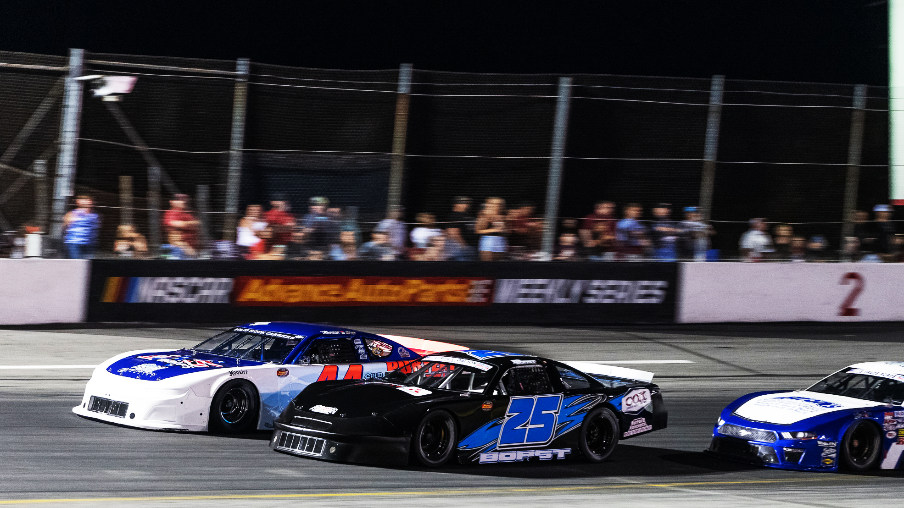
Fun. Fast. Authentic.

